Slide 1

Algorithms & Complexity 1/10
“Overview”
10th May 2019
Dr. Rasika Ranaweera (ranaweera.r@nsbm.lk | +94 11 544 6126)
School of Computing | NSBM

Slide 2


Contents (summary)
History and overview
Importance, basic algorithms
Complexity, strategies
Basic algorithmic analysis
Asymptotic analysis, best, average, and worst case behaviors
Big “O,” time and space tradeoffs
Algorithmic strategies
Brute-force/exhaustive
Computing algorithms
Sorting, searching
Basic computability theory
finite Automata
Notes:
Paint the big picture

Slide 3
Definition: Algorithm
A computer algorithm is
A detailed step by step method for solving a problem
A sequence of clear-cut instructions for solving the problem in a finite amount of time.
Any well defined computational procedure that takes collection of elements as input and procedures collection of elements as output.
A set of rules for carrying out calculation either by hand or on a machine.
An abstraction of a program to be executed on a physical machine (model of computation).

Slide 4
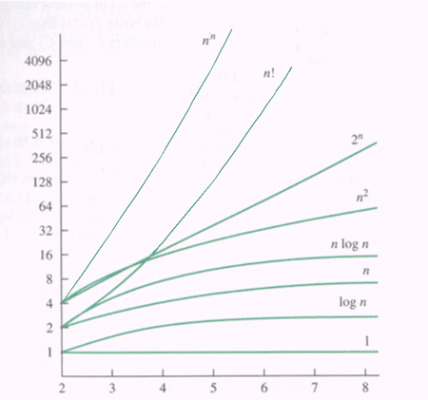
Purpose
To estimate how long a program will run.
To estimate the largest input that can reasonably be given to the program.
To compare the efficiency of different algorithms.
To help focus on the parts of code that are executed the largest number of times.
To choose an algorithm for an application.
http://cse.unl.edu/~ylu/raik283/notes/Algorithm-Analysis.ppt
Notes:
http://cse.unl.edu/~ylu/raik283/notes/Algorithm-Analysis.ppt

Slide 5
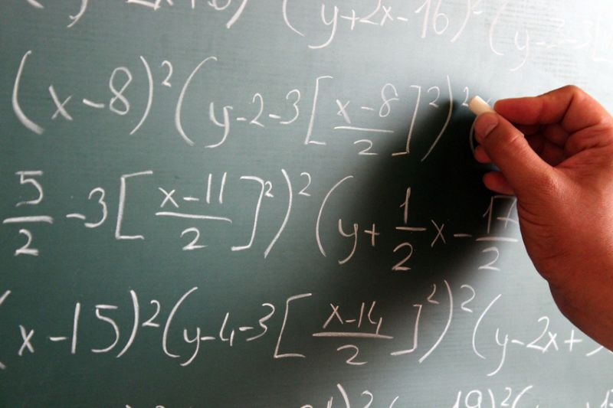
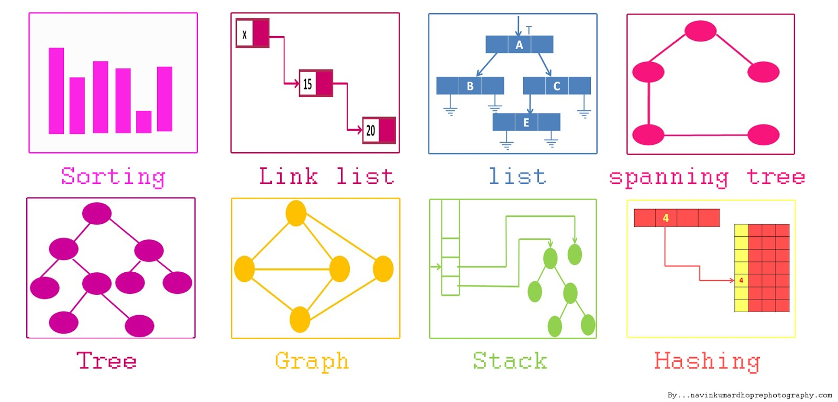
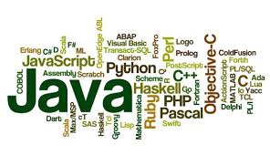
Prerequisites
Mathematics
Pseudocodes
Data Structures
Programming
Java, C#, Python, etc.
Loops, recursion

Slide 6
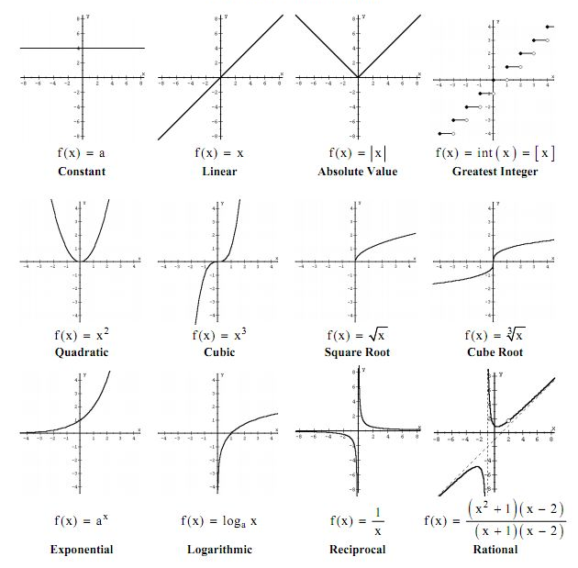
Quick Recap: Mathematical Functions
Name | Mathematics
Constant | y = K
Linear | y = x
Quadratic | y = x²
Exponential | y = a^{x}
Logarithmic | Log n

Slide 7
Quick Recap: Data Structures

Slide 8
Exercise I (Mathematics)
Suppose a machine that performs a million floating-point operations per second (10⁶ FLOPS), then how long an algorithm will run for an input of size n=50?
If the algorithm requires n² such operations:
0.0025s
If the algorithm requires 2^{n} such operations:
A) Takes a similar amount of time (t < 1 sec)
B) Takes a little bit longer time (1 sec < t < 1 year)
C) Takes a much longer time (1 year < t)
Notes:
Over 35 years
10⁶ -> 1s
2⁵⁰ ~ 10¹⁰

Slide 9
Exercise II (Algorithms & Programming)
Problem: Given a list of positive numbers, return the largest number on the list.
Algorithm
Implementation
Notes:
http://fiftyexamples.readthedocs.io/en/latest/algorithms.html

Slide 10
Exercise II (Algorithms & Programming)
Problem: Given a list of positive numbers, return the largest number on the list.
Algorithm:
Set max to -MAX.
Scan an item x in the list L, compare it to max. If x is larger, set max to x.
max is now set to the largest number in the list.
Notes:
http://fiftyexamples.readthedocs.io/en/latest/algorithms.html

Slide 11
Exercise II (Algorithms & Programming)
Problem: Given a list of positive numbers, return the largest number on the list.
Algorithm:
Set max to 0.
Scan an item x in the list L, compare it to max. If x is larger, set max to x.
max is now set to the largest number in the list.
Implementation:
double findMax(double[] L)
double max = 0
for (x in L)
if (x > max)
max = x
return max
Notes:
http://fiftyexamples.readthedocs.io/en/latest/algorithms.html

Slide 12
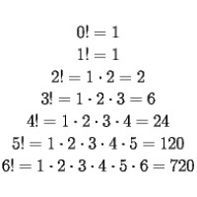
Exercise III (Recursion)
// 0! = 1, 1! = 1
// n! = n * (n - 1)!
int factorial(int n) {
// initial condition
if (n == 0)
return 1;
else
// recurring section
return (n * factorial(n-1));
}
Notes:
Over 35 years
10⁶ -> 1s
2⁵⁰ ~ 10¹⁰

Slide 13
Searching Algorithms
Searching algorithms aim to find position of a target value within an array/list.
Selection, merge, linear, binary, jump, ternary
Linear Search
Go through every element until found
Binary Search
Compare with mid point, eliminate irrelevant half in sorted array
Divide-and-conquer

Slide 14
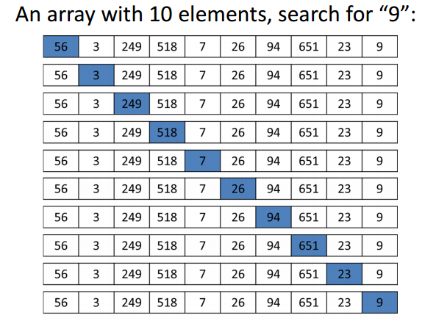
Linear Search

Slide 15
Linear Search: Psuedocode
function linearSearch(items, target)
for i from 0 to length – 1
if items[i] == target
return i
return not found

Slide 16
Linear Search: Java Implementation
public static int linearSearch(float[] items, float target) {
for (int index = 0; index < items.length; index++) {
if (items[index] == target) {
return index;
}
}
// element could not be found in the list
return -1;
}

Slide 17
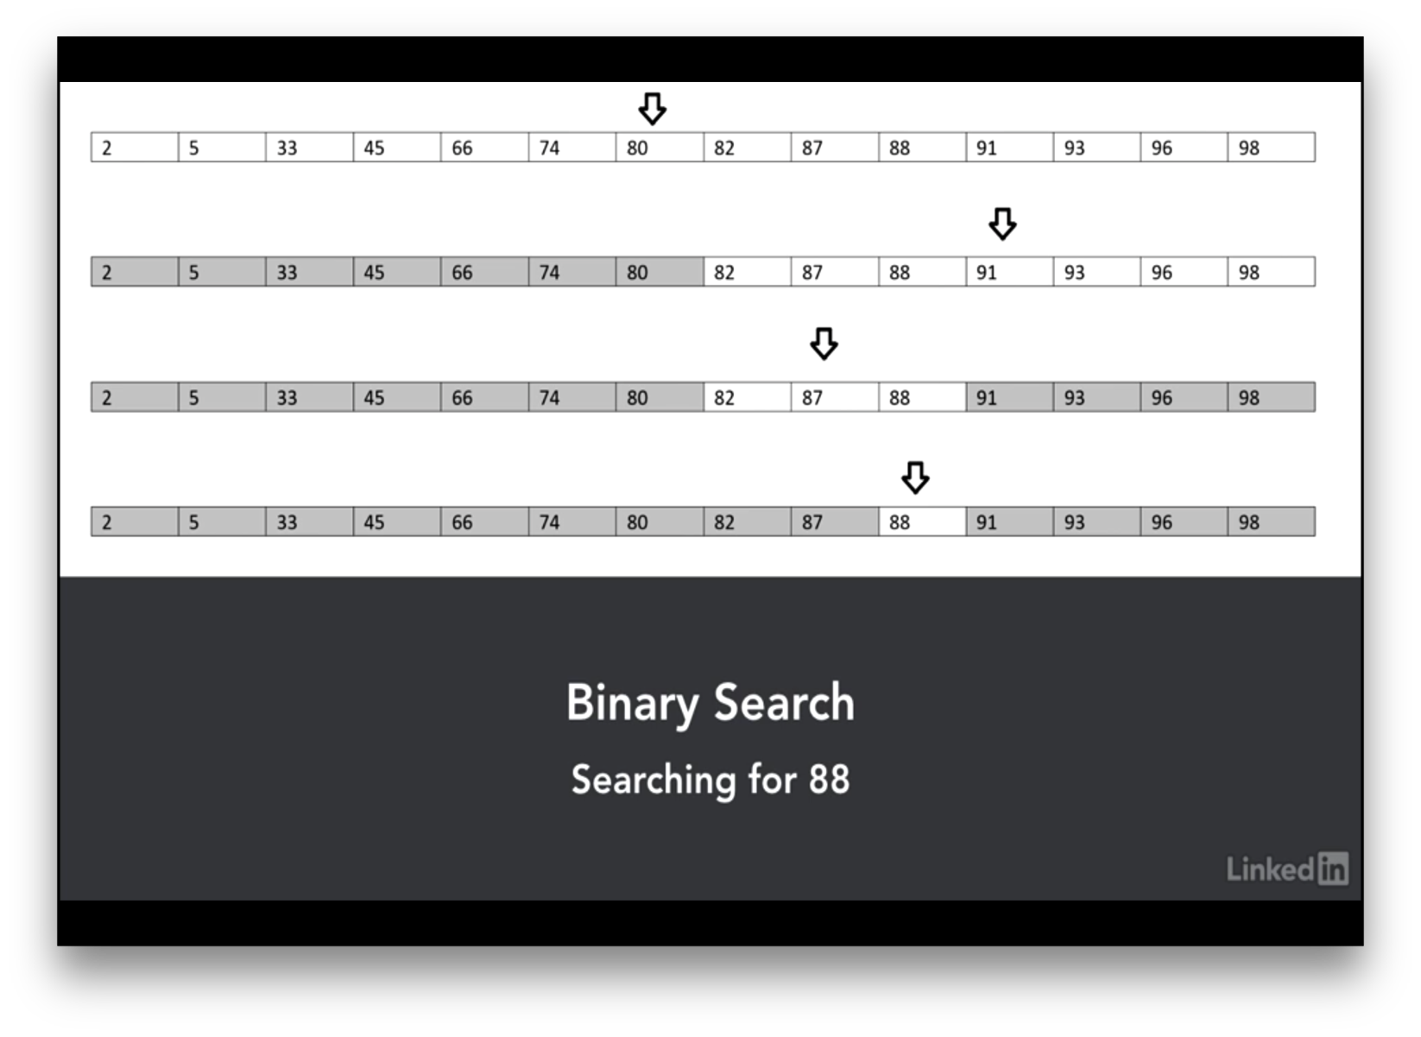
Binary Search

Slide 18
Binary Search: Psuedocode
// left and right are the ranges in item list
function binarySearch(items, target, left, right)
while left ≤ right
mid := floor((right+left) / 2)
if items[mid] = target
return mid
if target < items[mid]
right := mid-1
else
left := mid+1
return not found

Slide 19
Binary Search: Java Implementation
public static int binarySearch(float[] items, float target) {
int beginingOfRange = 0;
int endOfRange = items.length; // end of the range
while (beginingOfRange <= endOfRange) {
int midPoint = (beginingOfRange + endOfRange) / 2;
if (target < items[midPoint]) {
endOfRange = midPoint - 1;
} else if (target > items[midPoint]) {
beginingOfRange = midPoint + 1;
} else {
return midPoint;
}
}
// element could not be found in the list
return -1;
}

Slide 20
Comparison: Linear vs. Binary Search
Best case scenario
Single comparison
Worst case scenarios
Linear: search through whole list n
Binary: search through all halves log₂n
Binary search has additional requirement; sorting
Sorting is expensive (Even Quick sort as worst case of O(n²))
Effective if searched multiple times
Notes:
http://slideplayer.com/slide/8415061/

Slide 21
Binary Search: Complexity Explained
How many times (x) you divide N by 2 until you have 1?
1 = N / 2^{x}
2^{x} = N
log₂(2^{x}) = log₂N
x log₂2 = log₂N
x = log₂N because log₂2 = 1
Notes:
http://fiftyexamples.readthedocs.io/en/latest/algorithms.html

Slide 22
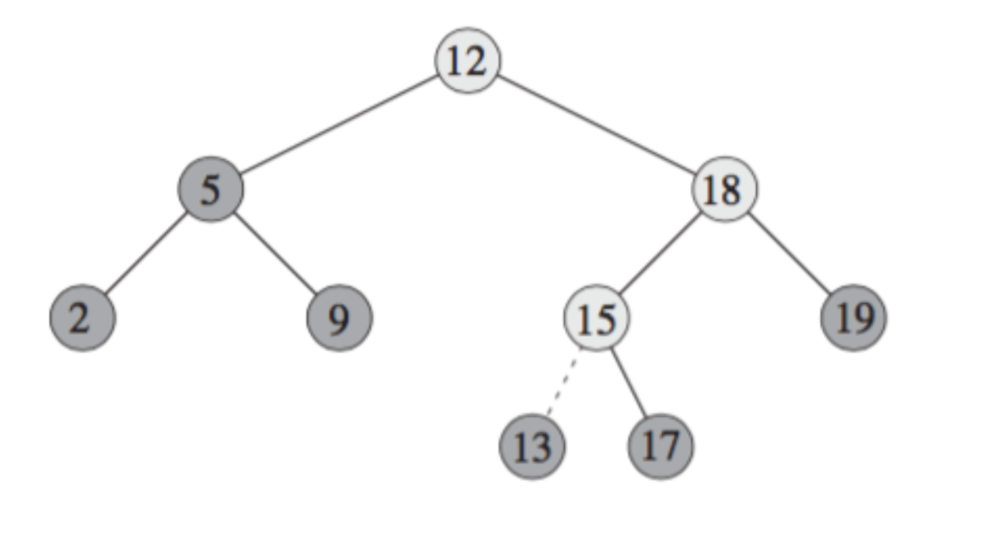
Binary Search Tree (BST)
Each node contains one key
Left sub-tree are less then the key in its parent node, in short L < P;
Right sub-tree are greater the key in its parent node, in short P < R;
No duplicate keys
Notes:
https://www.cs.cmu.edu/~adamchik/15-121/lectures/Trees/trees.html

Slide 23
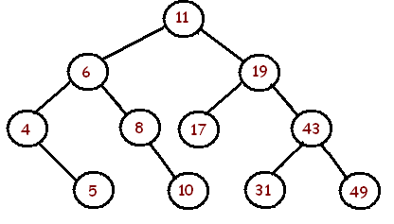
Exercise (Binary Tree)
Problem: Draw a binary search tree by inserting the following numbers from left to right.
11, 6, 8, 19, 4, 10, 5, 17, 43, 49, 31
Notes:
http://fiftyexamples.readthedocs.io/en/latest/algorithms.html

Slide 24
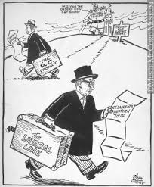
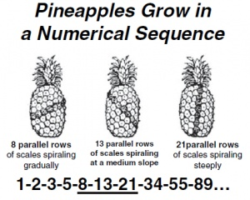
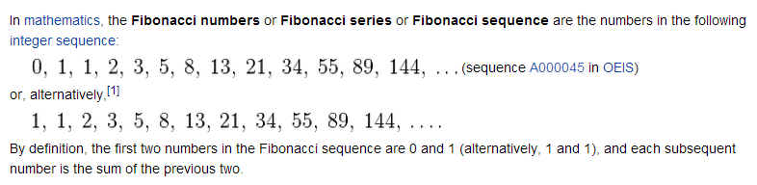
Homework?
Travelling Salesman problem
Fibonacci series
Towers of Hanoi

Slide 25
Homework?
Travelling Salesman problem
Fibonacci series
Towers of Hanoi

Slide 26

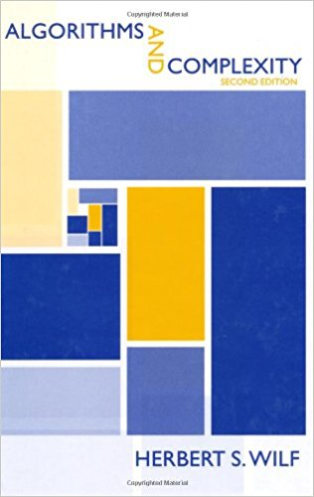
Learning Materials
BOOKS
Y. Peralman
Ganitha Vinodaya
Herbert S Wilf
Algorithms and Complexity
Lynda.com
Michele Vallisneri, “Algorithm Complexity”
Notes:
"Computers are incredibly fast, accurate, and stupid; humans are incredibly slow, inaccurate and brilliant; together they are powerful beyond imagination." - Einstein

Slide 27


Q & A

